Slide 1
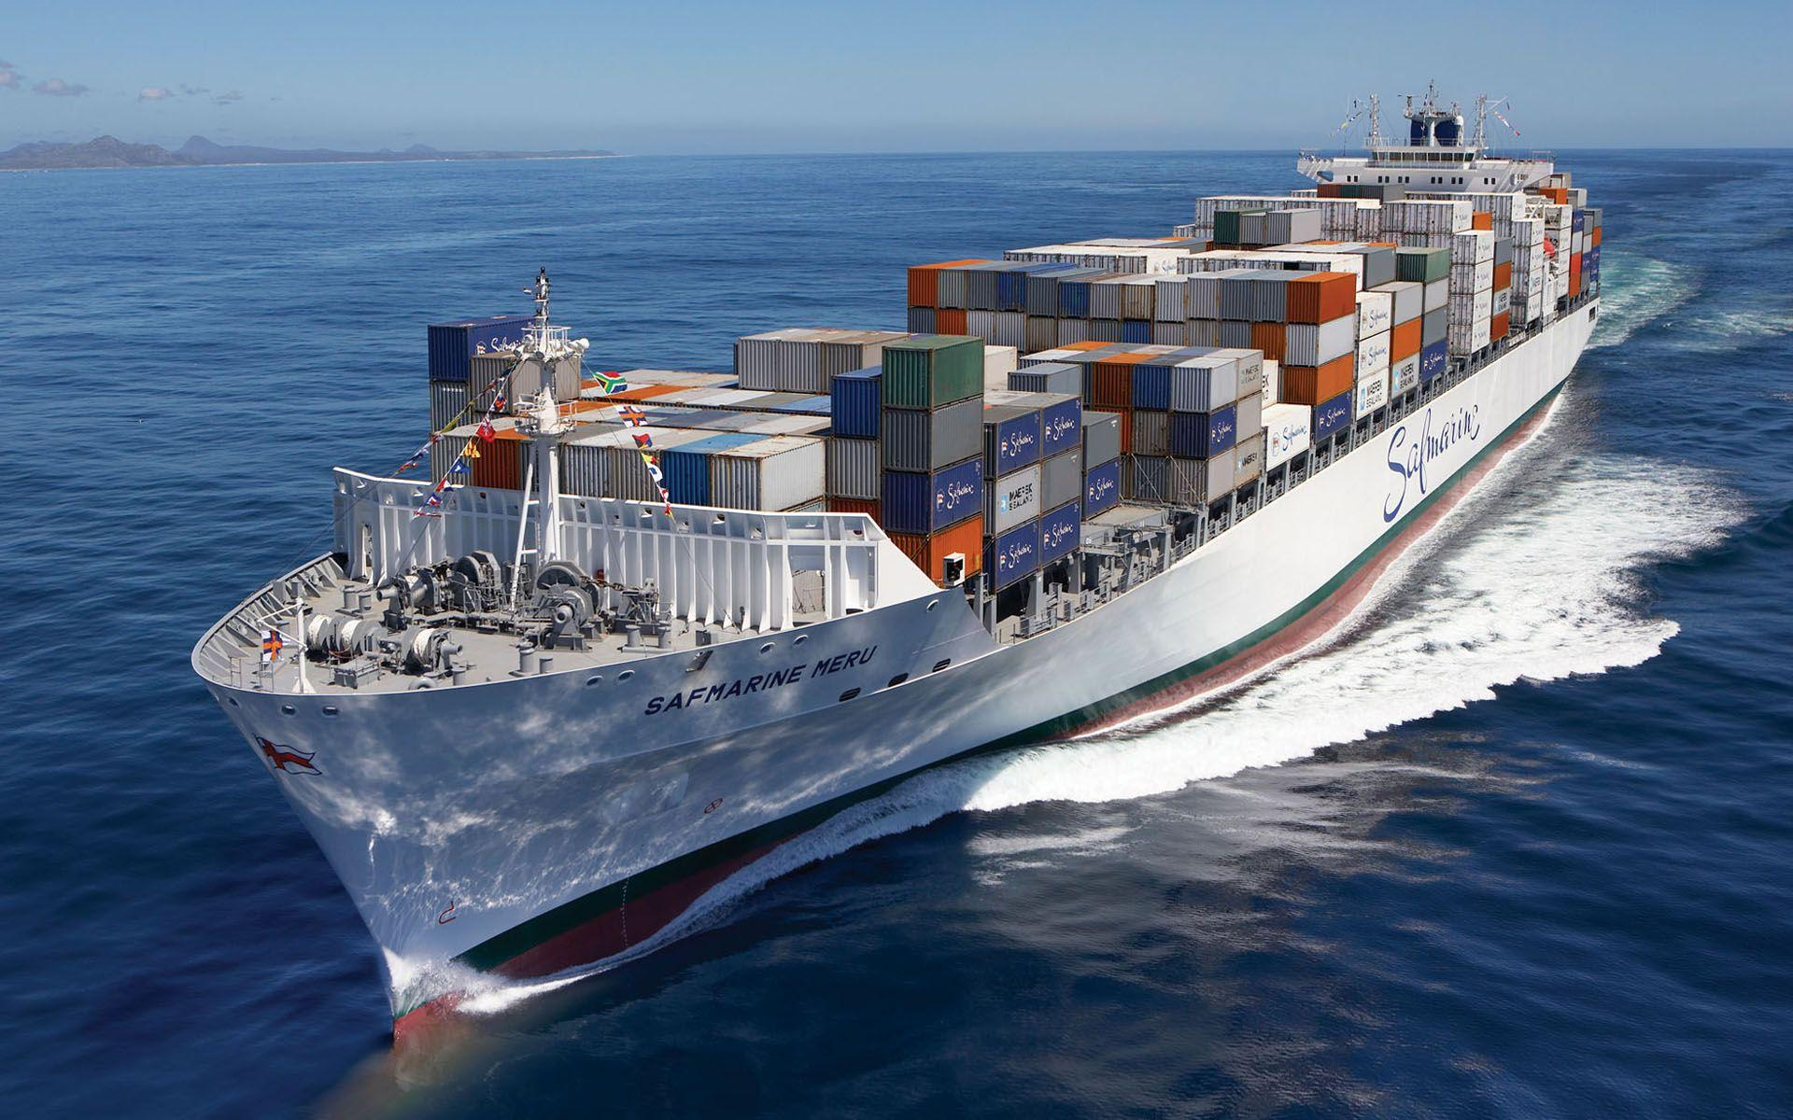
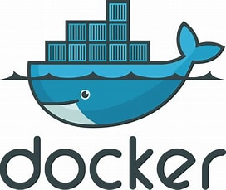
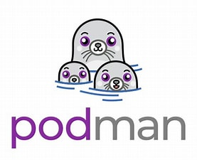
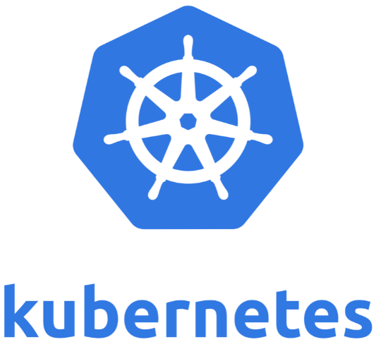
Containerization Technical Overview
https://cargoholidays.com
By Isaac Lubbers

Slide 2
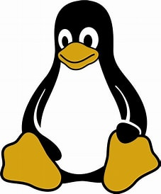
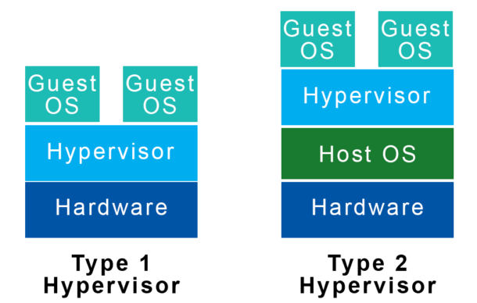
What Is Virtualization?
The action of isolating an operating system on the hardware level from other operating systems on the hypervisor, or below the hypervisor.
https://helpdeskgeek.com

Slide 3
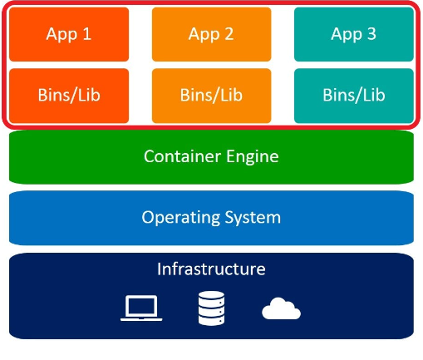
What Is Containerization?
The action of isolating one or more processes or applications on the kernel level from the rest of the Operating System.
A feature of the Linux kernel
https://medium.com
Notes:
Chroot – 1982 on Unix, process has different root filesystem. If root process, can still do anything
FreeBSD Jail – 1999, similar to a VM, same kernel as host, greater security
LXC (linux containers) project – 2008, first intro to containers
Docker release 2013

Slide 4
What Is A Container?
An isolated instance of a running application or process
Posses only the required libraries and software dependencies to function independently from the host OS
Notes:
Chroot – 1982 on Unix, process has different root filesystem. If root process, can still do anything
FreeBSD Jail – 1999, similar to a VM, same kernel as host, greater security
LXC (linux containers) project – 2008, first intro to containers
Docker release 2013

Slide 5
Virtualization
Containerization
Hardware level isolation
Large (GB’s in size)
Higher resource allocation
More permanent in nature
Less elastic/scalable
VM snapshots, backups
Applications are less portable
Slower to start up and shut down
Less complex to secure, more isolation
Less complex to build and maintain
Platforms: VMware, KVM/QEMU, Virtual Box
Orchestration: EC2 Auto Scaling (AWS), Virtual Machine Scale Sets (Azure)
Kernel level isolation
Lightweight (MB’s in size)
Lower resource allocation
Ephemeral in nature
More elastic/scalable
Relies on host OS for backups
Makes applications portable
Faster to start up and shut down
Added complexity to secure, less isolation
Added complexity when building and maintaining
Container Runtimes: Docker, Podman, Containerd
Orchestration: Kubernetes, Red Hat OpenShift, Amazon Elastic Kubernetes Service (EKS), Azure Kubernetes Service (AKS)

Slide 6
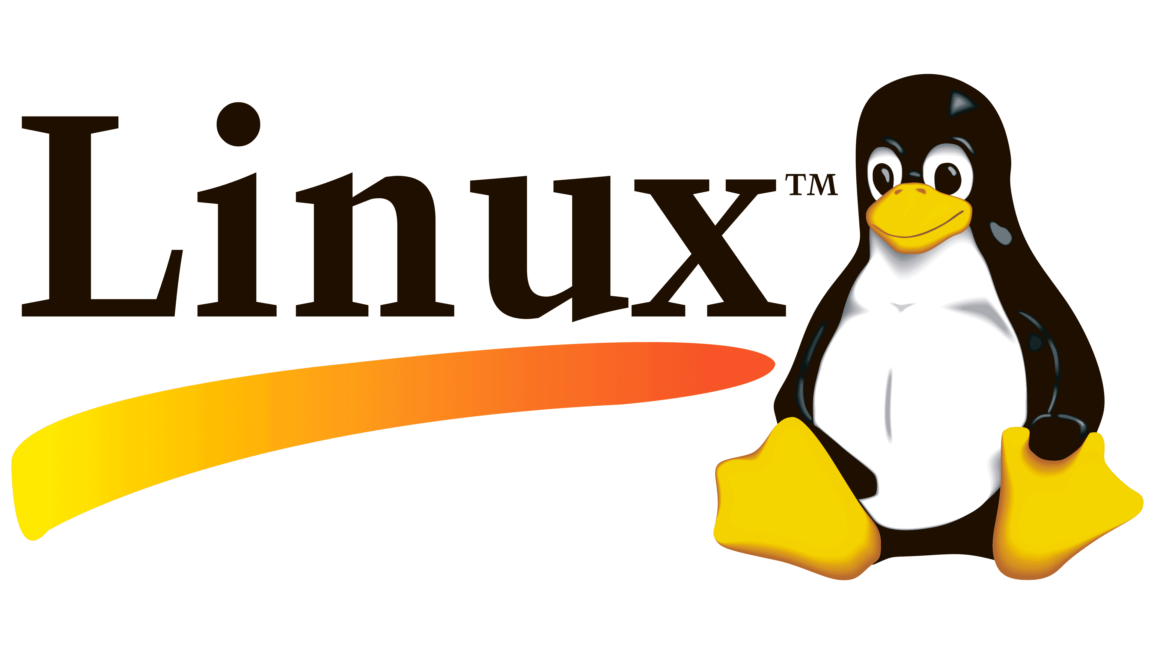
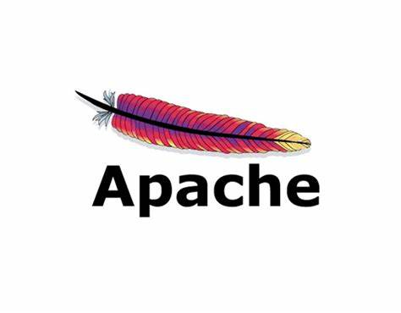
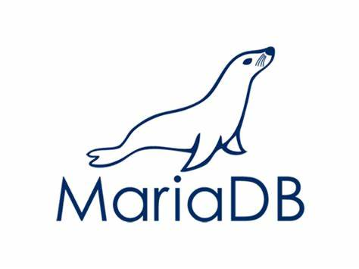
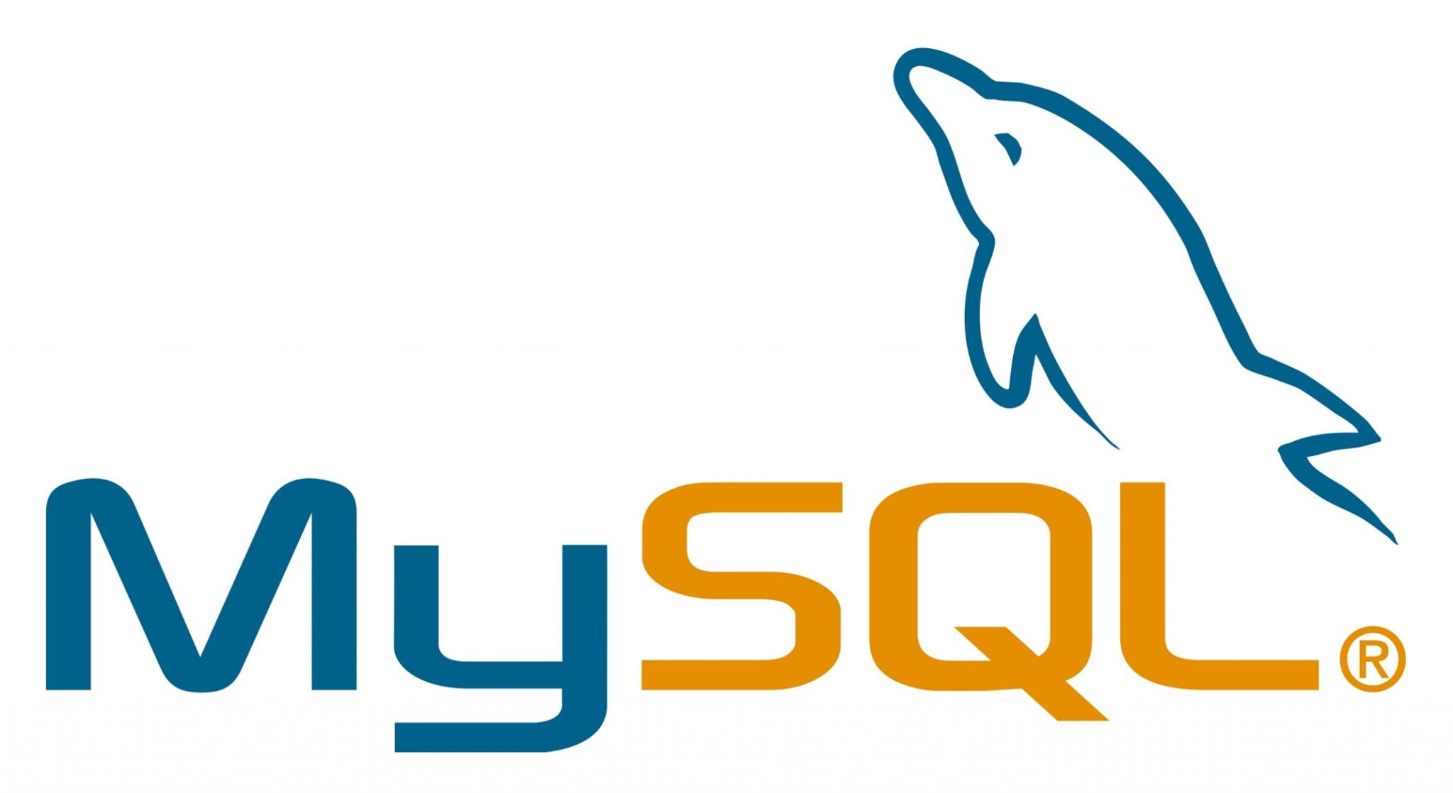

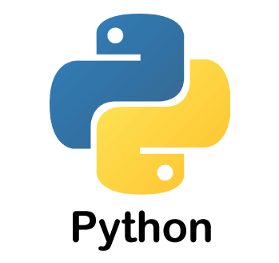
Example Application Stack
L A M P
Application Stack:
A group of intercommunicating software programs that work together to achieve a common goal.
or
or

Slide 7

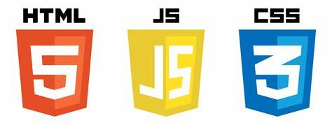
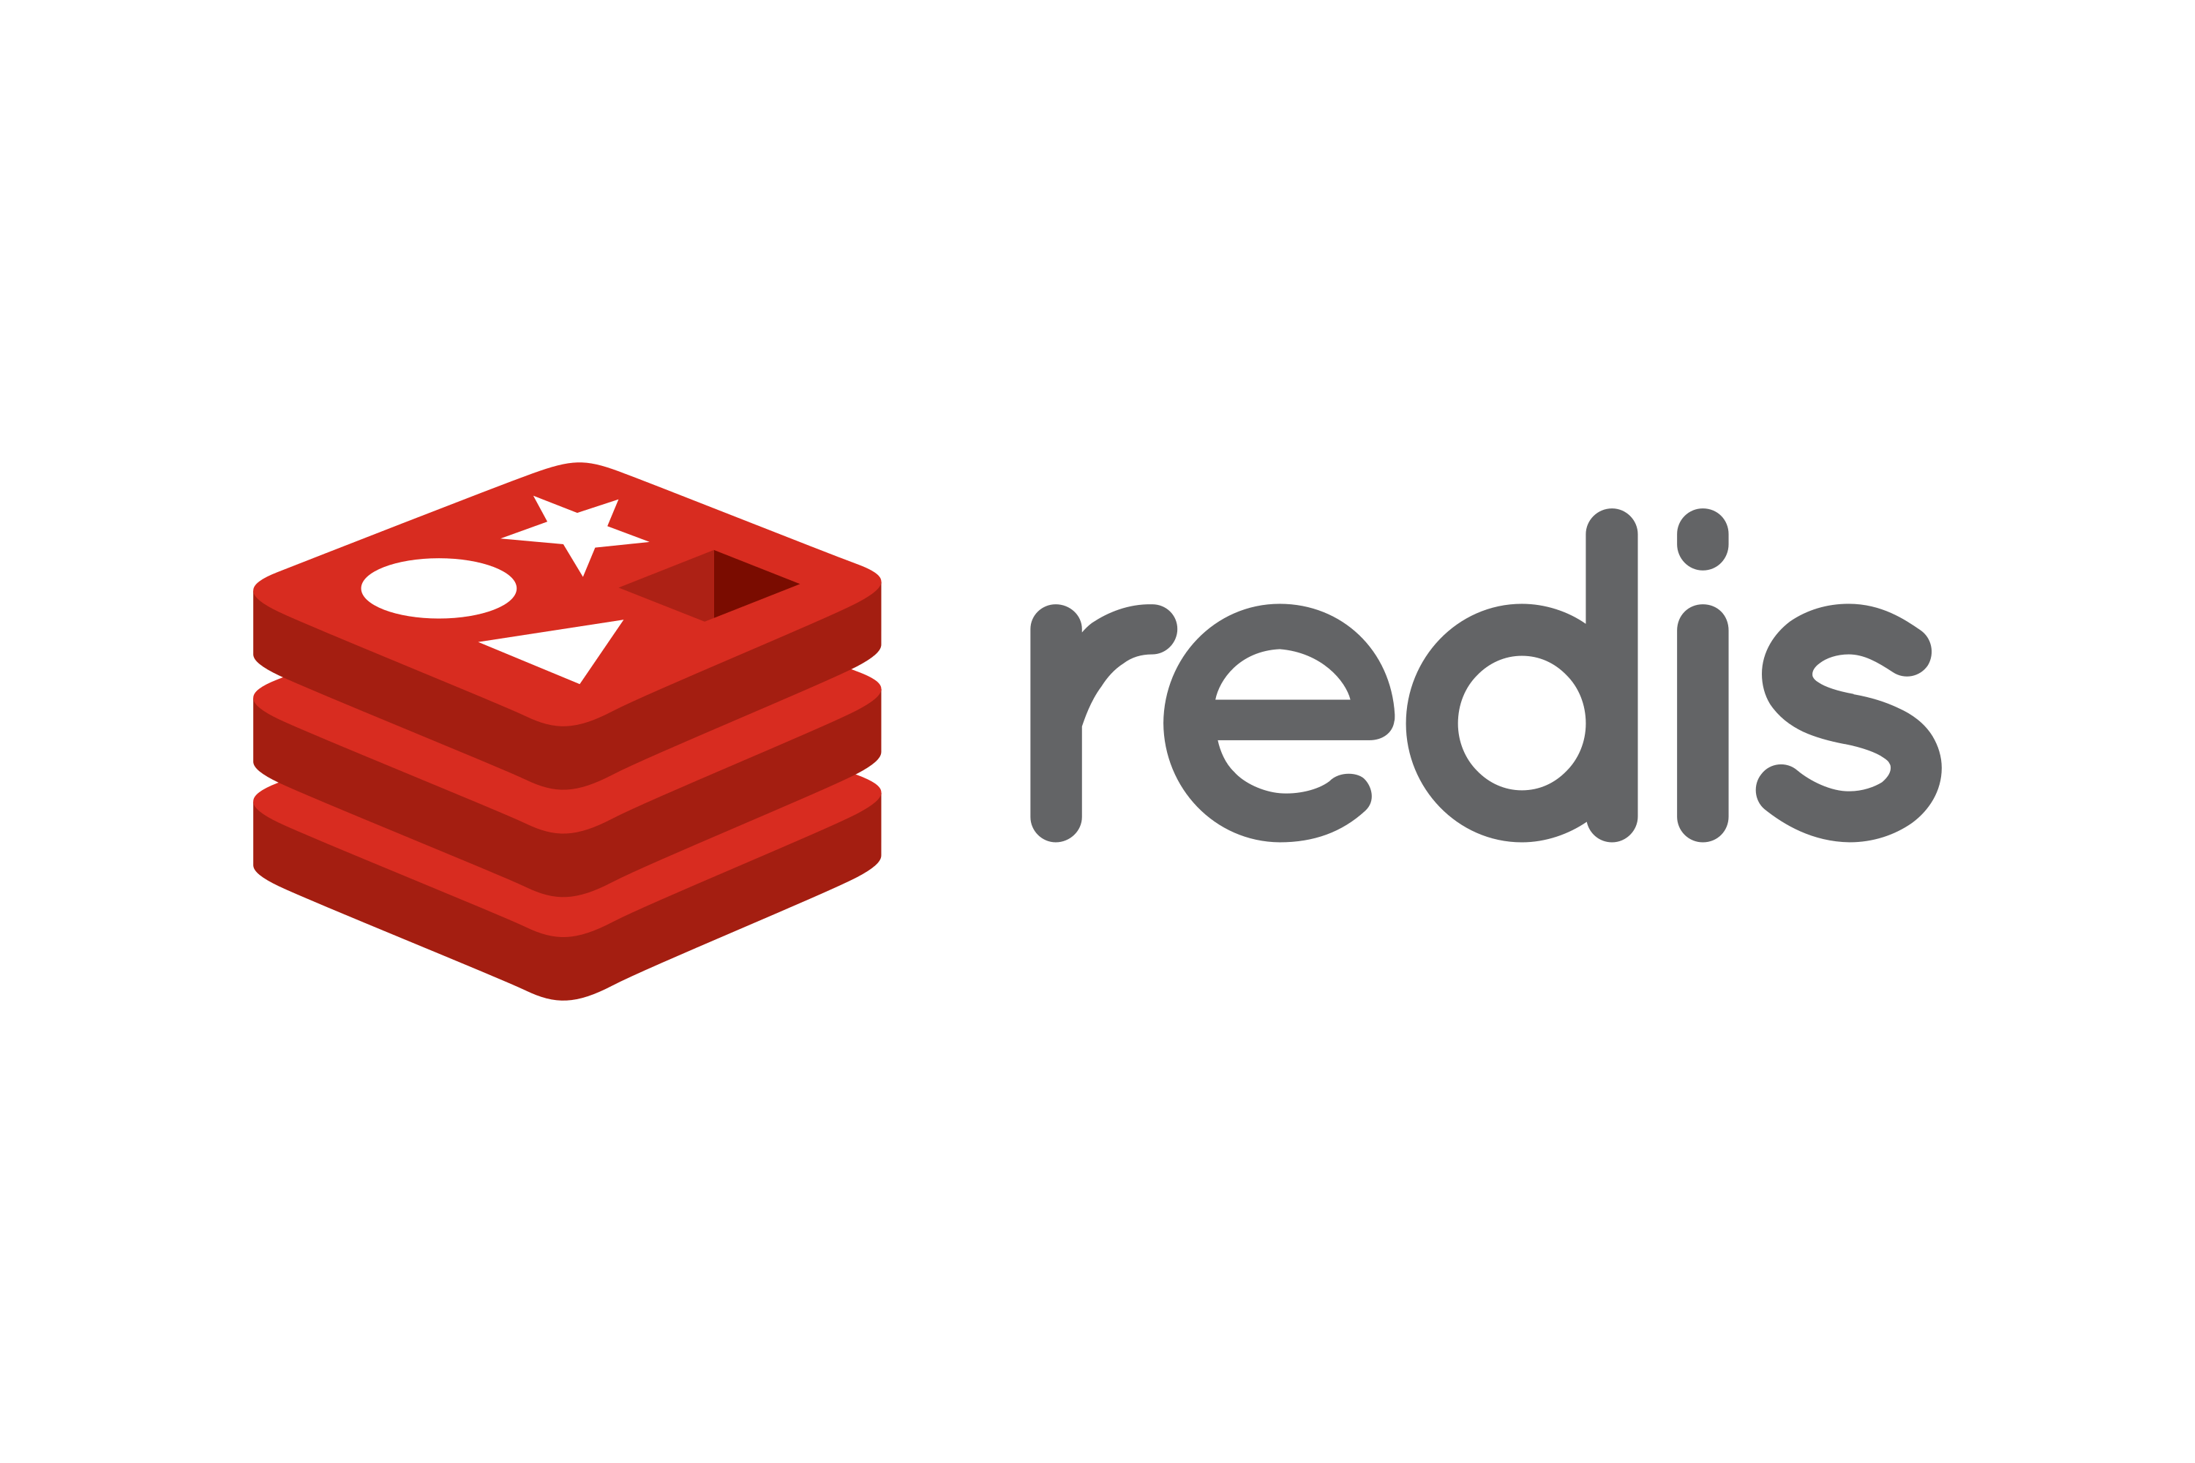
Single Physical Server Solution:
Linux Server
(Web Server, Front End)
(Back end)
(Cache Database)
(Relational Database)

Slide 8
Single Physical Server Solution:
Pros
Cons
Simple temporary solution for a small business
No network latency between applications
Impossible to scale efficiently
Applications compete for server resources
Harder to navigate application dependency conflicts
Stuck with one operating system only
Zero Redundancy incase of failure
Insecure - database could be accessed from public internet - violation of STIG Rules: SV-15265r4_rule (Medium) and SV-84915r1_rule (Critical)
Notes:
SV-15265r4_rule: All Internet-facing applications must be hosted in a DoD Demilitarized Zone (DMZ) Extension.
SV-84915r1_rule: Application web servers must be on a separate network segment from the application and database servers if it is a tiered application operating in the DoD DMZ.

Slide 9
Multiple Virtual Machine Solution:
VM 1
VM 2
(Web Server, Front end)
(Back end)
DMZ VM
VM 3
VM 4
(Reverse Proxy)
(Reverse Proxy)
(Relational Database)
(Cache Database)

Slide 10
Multiple Virtual Machine Solution:
Why It’s Better?
Secure, segmented network
Snapshots!
Applications cannot compete for computing resources on other VM’s
Flexibility with operating systems
Scalable and cloneable
Lower risk of application dependency conflicts if VM duties are segmented correctly
Notes:
SV-15265r4_rule: All Internet-facing applications must be hosted in a DoD Demilitarized Zone (DMZ) Extension.
SV-84915r1_rule: Application web servers must be on a separate network segment from the application and database servers if it is a tiered application operating in the DoD DMZ.

Slide 11

Container and Virtual Machine Solution:
VM
PRoxy
DMZ
(Reverse Proxy)
VM

Slide 12
Container and Virtual Machine Solution:
Why Adding Containers Can Be Best?
Most efficient use of computing resources
Rapidly scalable
No risk of application dependency conflicts
Applications can be ported to different VM’s easily
Combined benefits of both containers and virtual machines
Notes:
SV-15265r4_rule: All Internet-facing applications must be hosted in a DoD Demilitarized Zone (DMZ) Extension.
SV-84915r1_rule: Application web servers must be on a separate network segment from the application and database servers if it is a tiered application operating in the DoD DMZ.

Slide 13
How Do Containers Work?
Utilize a container runtime to manage containers (run, kill, build, pull image from repository etc.)
Popular container runtimes include:
Docker
Podman
Containerd (Kubernetes)
RunC (low-level)
Notes:
Chroot – 1982 on Unix, process has different root filesystem. If root process, can still do anything
FreeBSD Jail – 1999, similar to a VM, same kernel as host, greater security
LXC (linux containers) project – 2008, first intro to containers
Docker release 2013

Slide 14
How Do Containers Work?
A container is a running container image
Pre-built container images can be run “as is” after pulling them from a repository
Custom container images can be built from a Containerfile or Dockerfile
Notes:
Chroot – 1982 on Unix, process has different root filesystem. If root process, can still do anything
FreeBSD Jail – 1999, similar to a VM, same kernel as host, greater security
LXC (linux containers) project – 2008, first intro to containers
Docker release 2013

Slide 15
Example 1: Apache Container
Notes:
Chroot – 1982 on Unix, process has different root filesystem. If root process, can still do anything
FreeBSD Jail – 1999, similar to a VM, same kernel as host, greater security
LXC (linux containers) project – 2008, first intro to containers
Docker release 2013

Slide 16
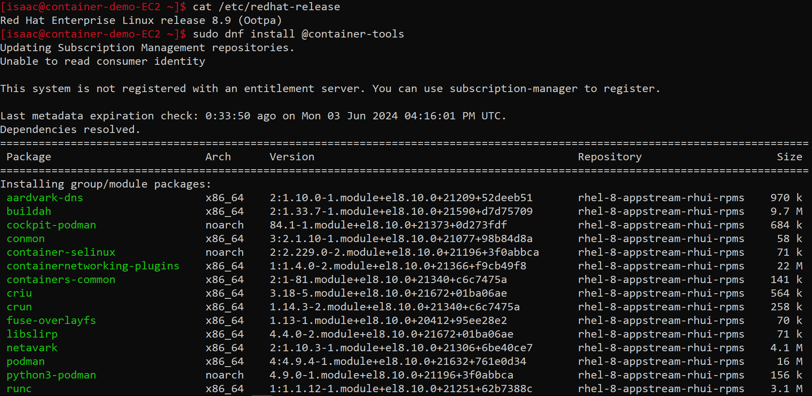

Slide 17
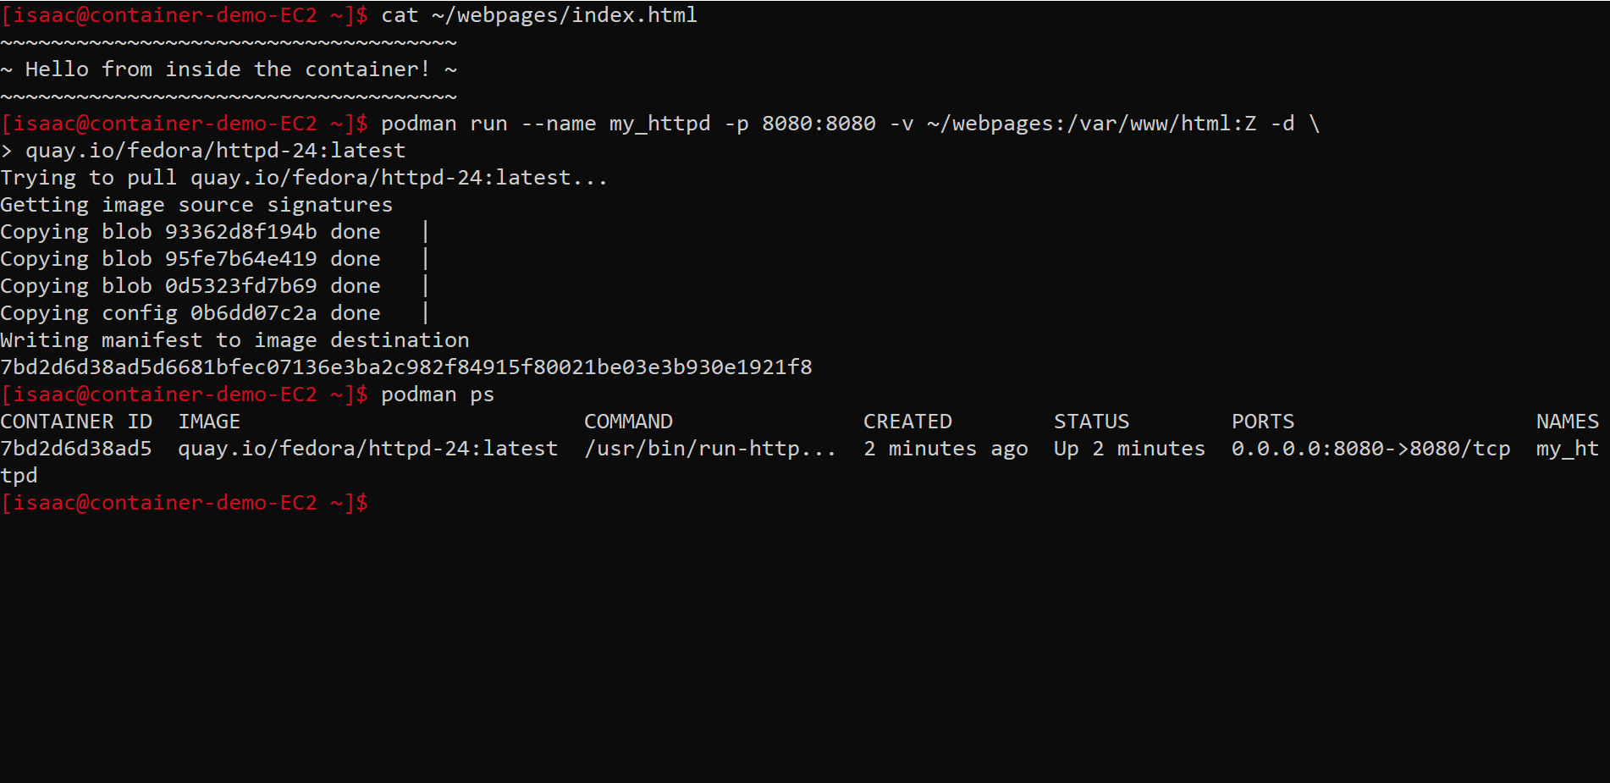

Slide 18
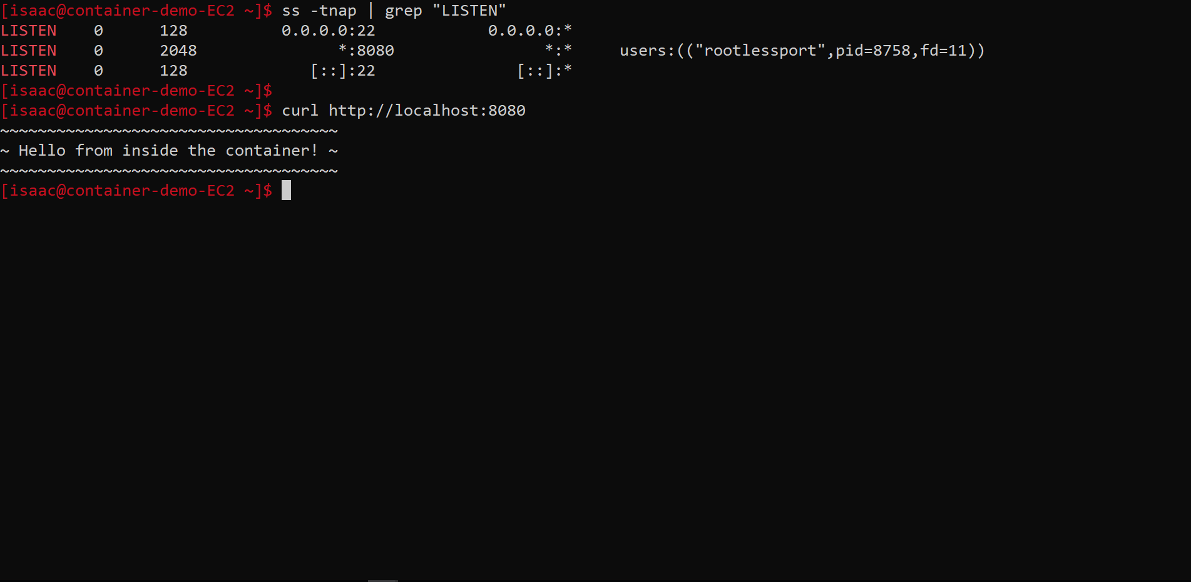

Slide 19
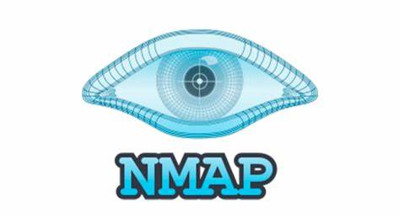
Example 2: Nmap Container
Notes:
Chroot – 1982 on Unix, process has different root filesystem. If root process, can still do anything
FreeBSD Jail – 1999, similar to a VM, same kernel as host, greater security
LXC (linux containers) project – 2008, first intro to containers
Docker release 2013

Slide 20
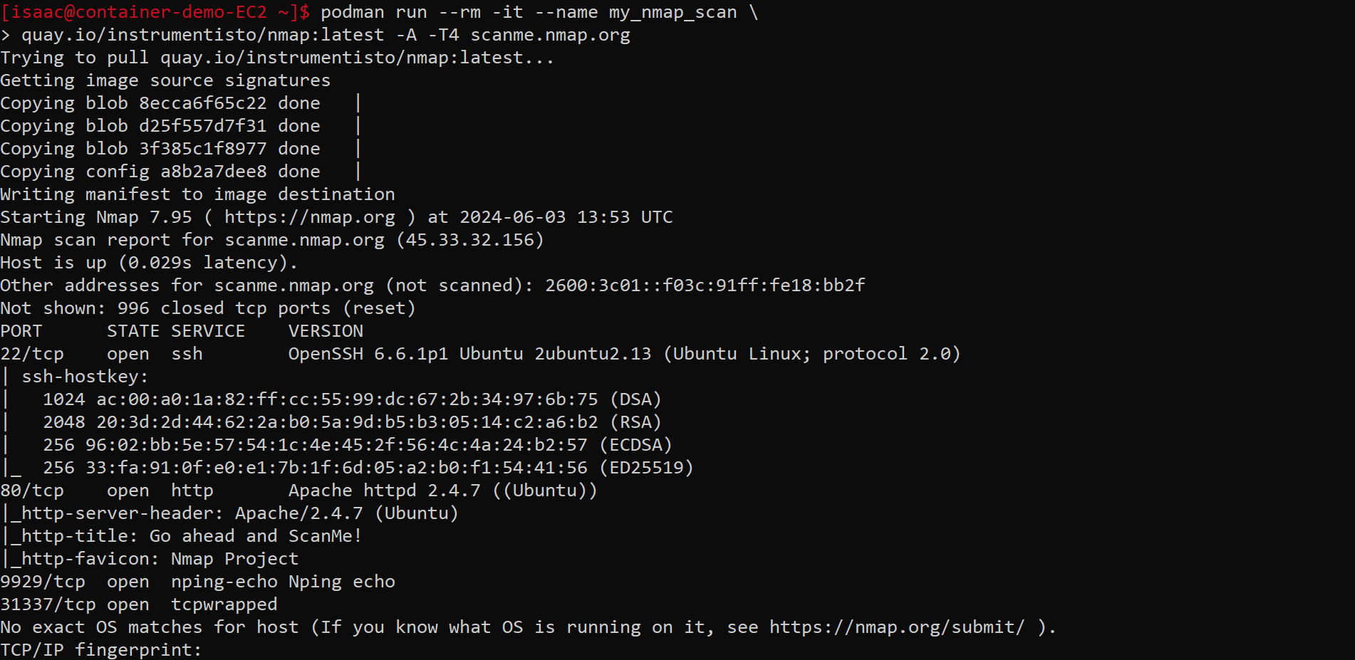

Slide 21
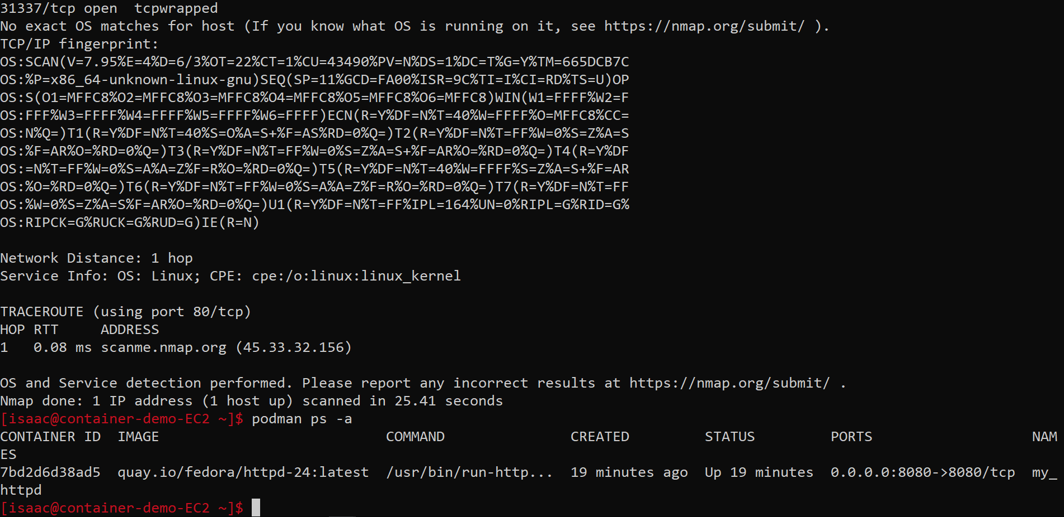

Slide 22
Example 3: MYSQL server Container
Notes:
Chroot – 1982 on Unix, process has different root filesystem. If root process, can still do anything
FreeBSD Jail – 1999, similar to a VM, same kernel as host, greater security
LXC (linux containers) project – 2008, first intro to containers
Docker release 2013

Slide 23
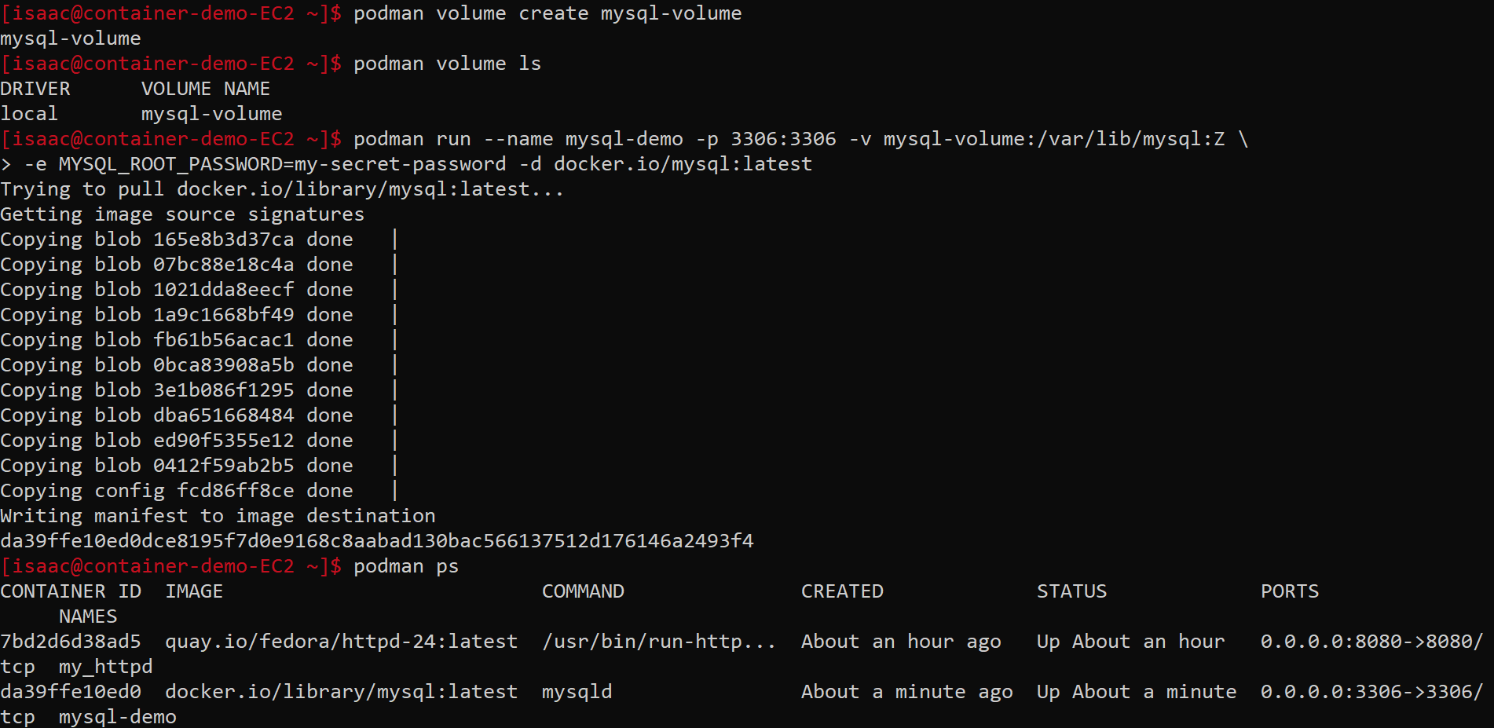

Slide 24
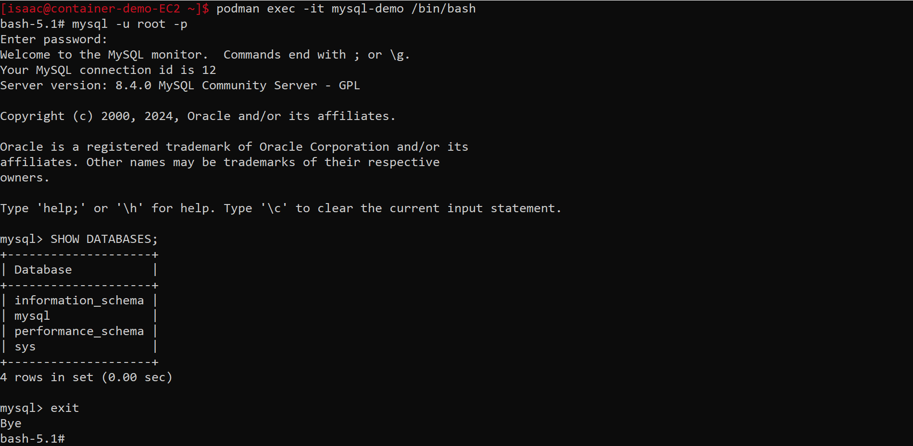

Slide 25
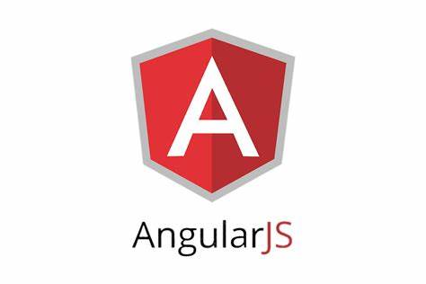
Example 4: Angular Web App Container
Notes:
Chroot – 1982 on Unix, process has different root filesystem. If root process, can still do anything
FreeBSD Jail – 1999, similar to a VM, same kernel as host, greater security
LXC (linux containers) project – 2008, first intro to containers
Docker release 2013

Slide 26
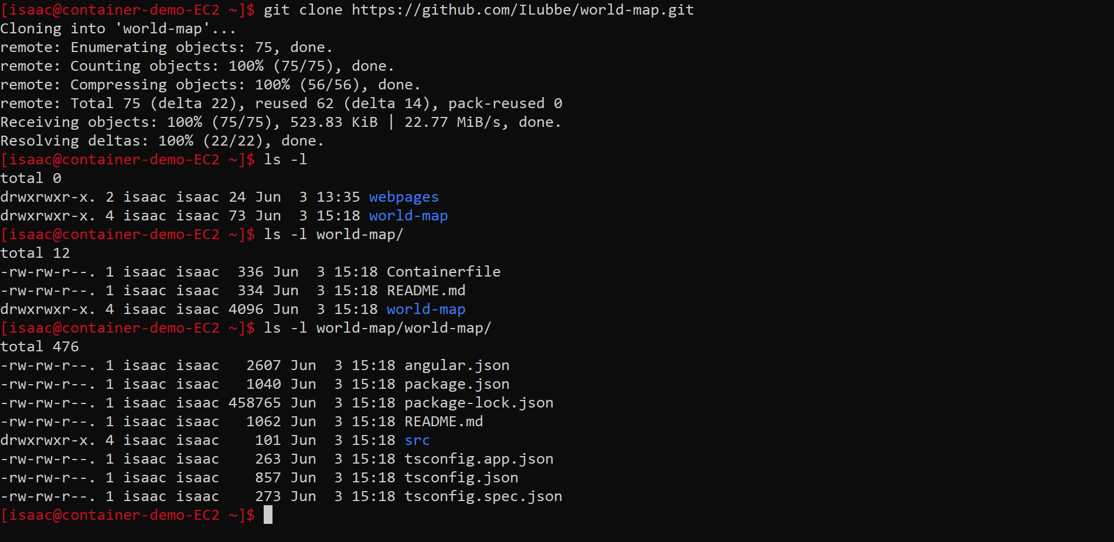

Slide 27
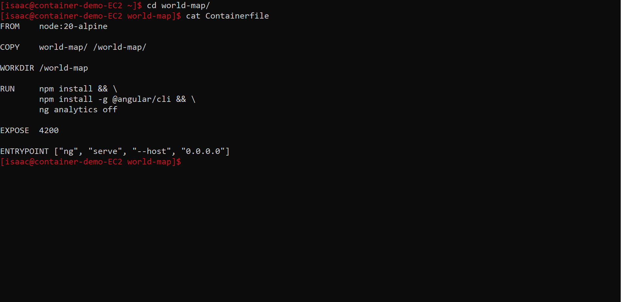

Slide 28
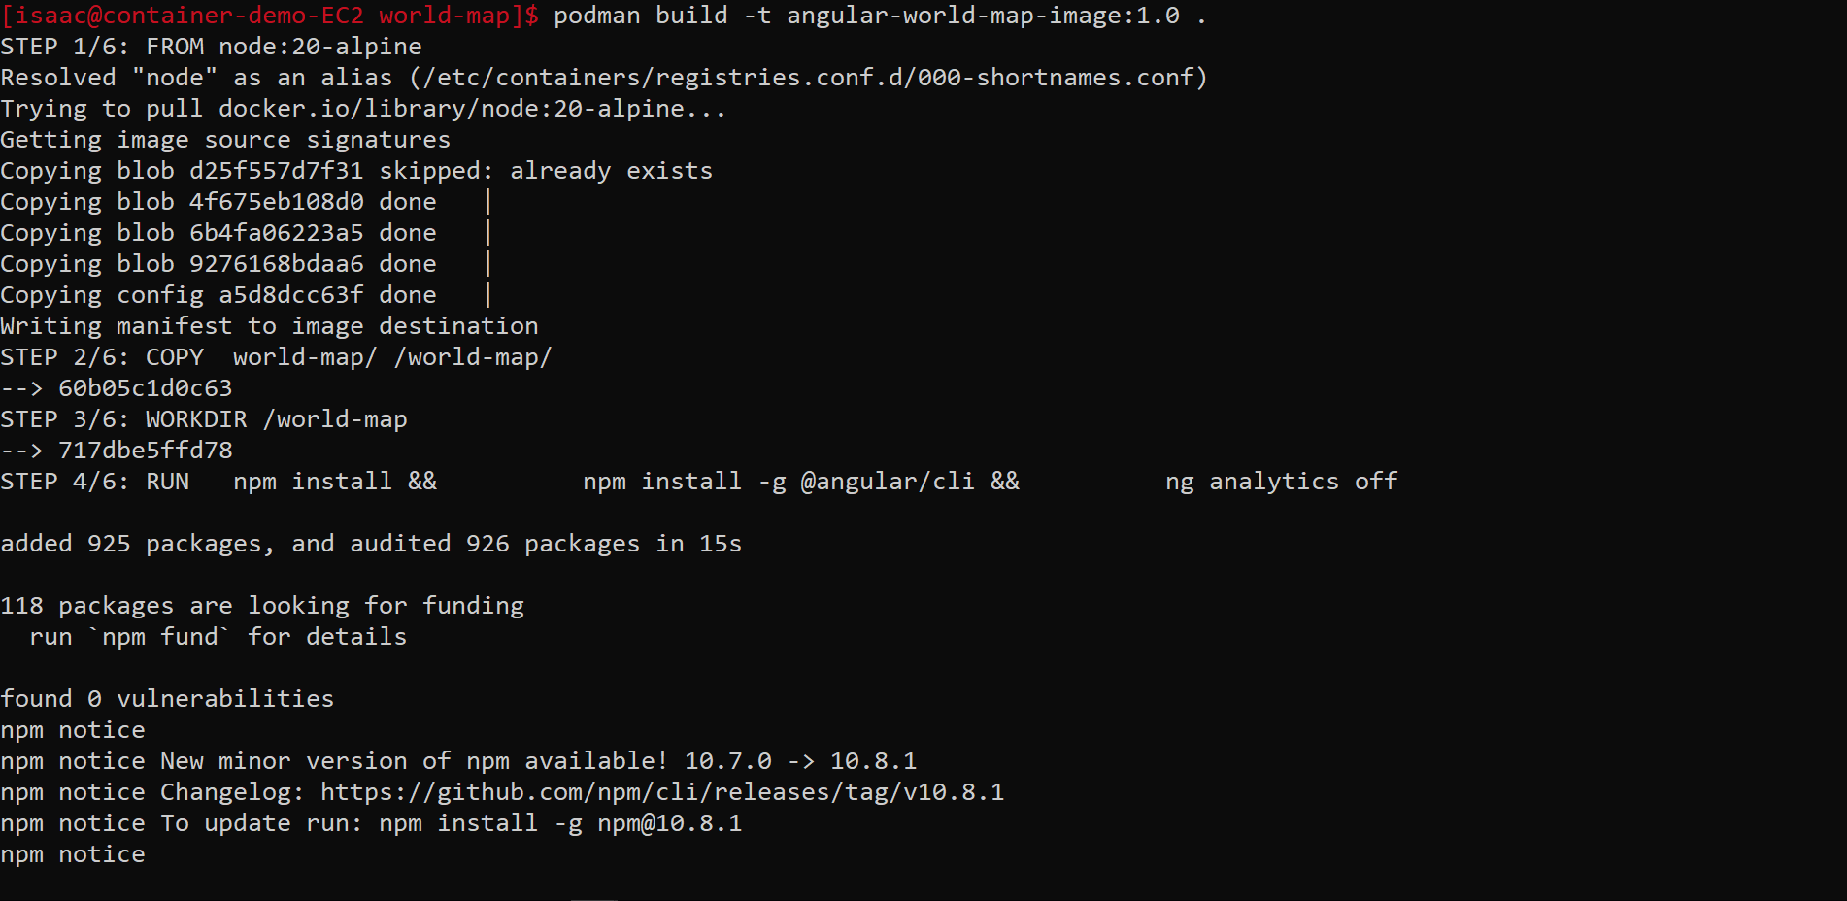

Slide 29
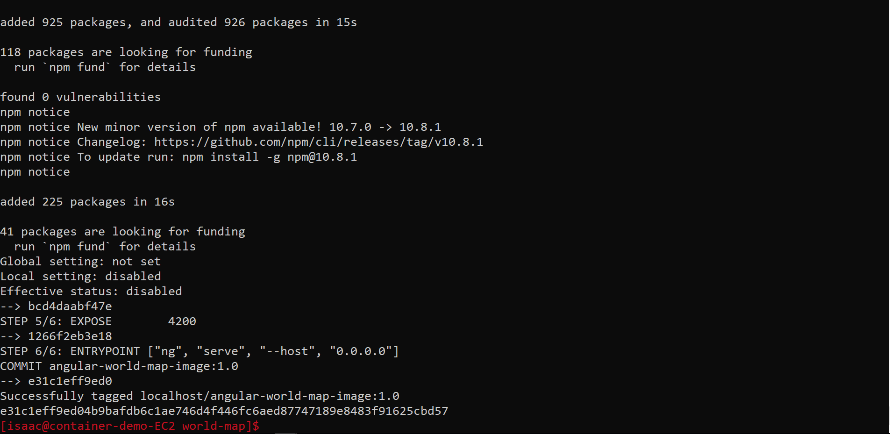
Build Continued…

Slide 30
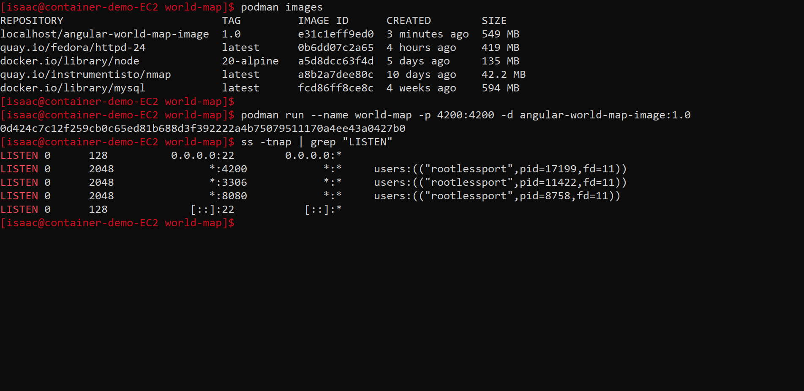

Slide 31
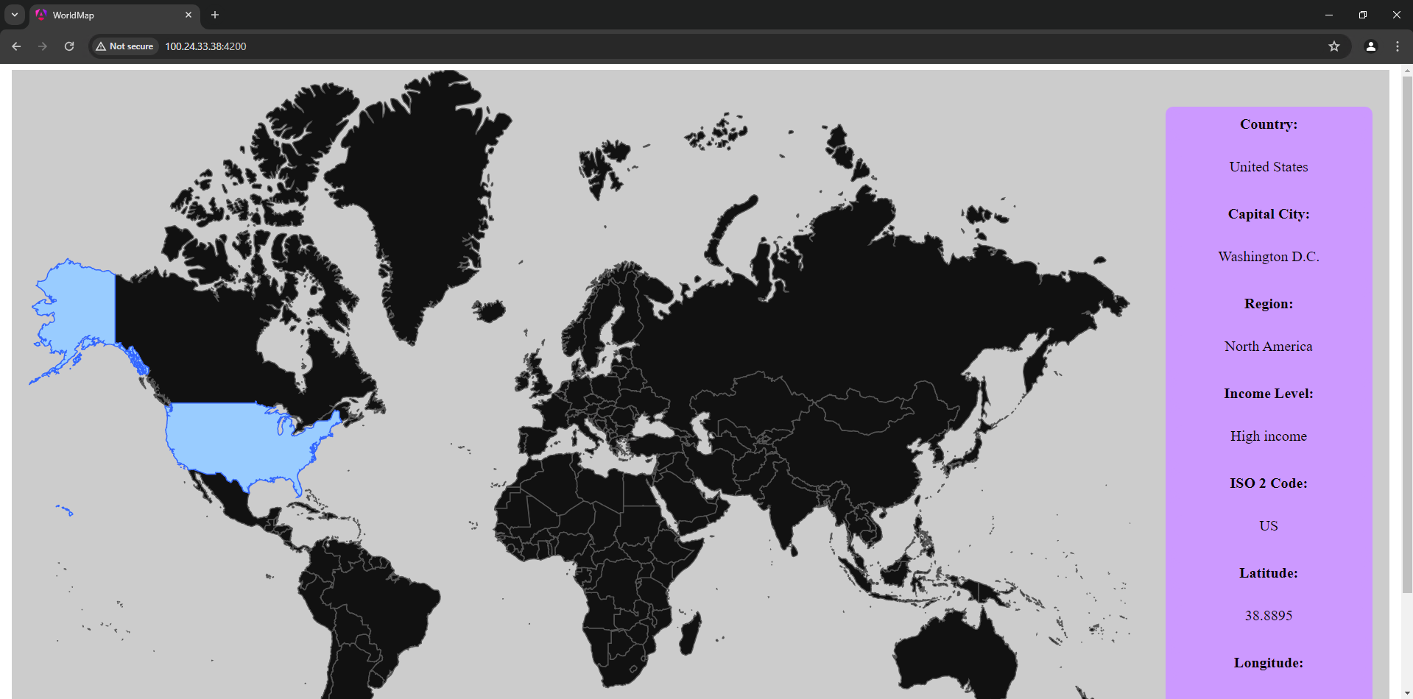

Slide 32
Containerfile Directives
ADD Add local or remote files and directories.
ARG Use build-time variables.
CMD Specify default commands.
COPY Copy files and directories.
ENTRYPOINT Specify default executable.
ENV Set environment variables.
EXPOSE Describe which ports your application is listening on.
FROM Create a new build stage from a base image.
HEALTHCHECK Check a container's health on startup.
https://docs.docker.com/engine/reference/builder/
Notes:
Chroot – 1982 on Unix, process has different root filesystem. If root process, can still do anything
FreeBSD Jail – 1999, similar to a VM, same kernel as host, greater security
LXC (linux containers) project – 2008, first intro to containers
Docker release 2013

Slide 33
Containerfile Directives (cont.)
LABEL Add metadata to an image.
MAINTAINER Specify the author of an image.
ONBUILD Specify instructions for when the image is used in a build.
RUN Execute build commands.
SHELL Set the default shell of an image.
STOPSIGNAL Specify the system call signal for exiting a container.
USER Set user and group ID.
VOLUME Create volume mounts.
WORKDIR Change working directory.
https://docs.docker.com/engine/reference/builder/
Notes:
Chroot – 1982 on Unix, process has different root filesystem. If root process, can still do anything
FreeBSD Jail – 1999, similar to a VM, same kernel as host, greater security
LXC (linux containers) project – 2008, first intro to containers
Docker release 2013

Slide 34
Useful Commands
podman network create <network name>
podman volume create <volume name>
podman inspect <container/image/network/vol etc.>
skopeo inspect <container image URL>
podman search <container image name>
podman pull <container image URL>
Podman push <container image URL>
podman stop <container name>

Slide 35
Useful Commands (cont.)
9. podman build -t <container image name> .
10. podman export -o <archive.tar> <container name>
11. podman import <archive.tar>
12. podman exec -it <container name> /bin/sh
13. podman exec <container name> <command>
14. podman logs <container name>
15. podman image rm <container image name>
16. podman rm <container name>

Slide 36
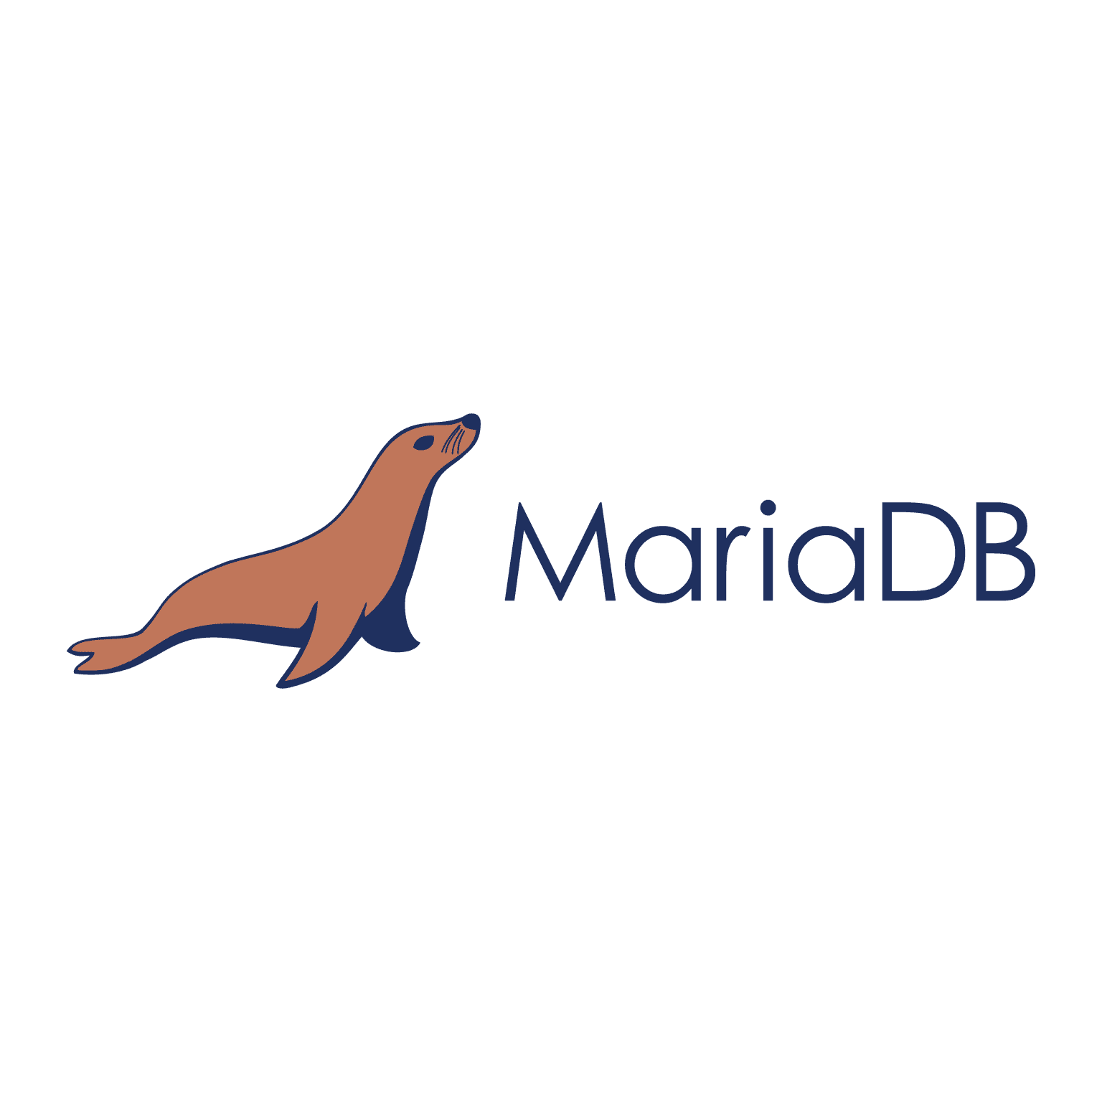
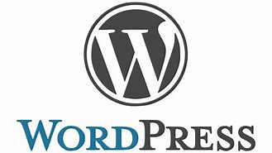
Example 5: MariaDB & Wordpress Stack with
Docker-Compose
Notes:
Chroot – 1982 on Unix, process has different root filesystem. If root process, can still do anything
FreeBSD Jail – 1999, similar to a VM, same kernel as host, greater security
LXC (linux containers) project – 2008, first intro to containers
Docker release 2013

Slide 37
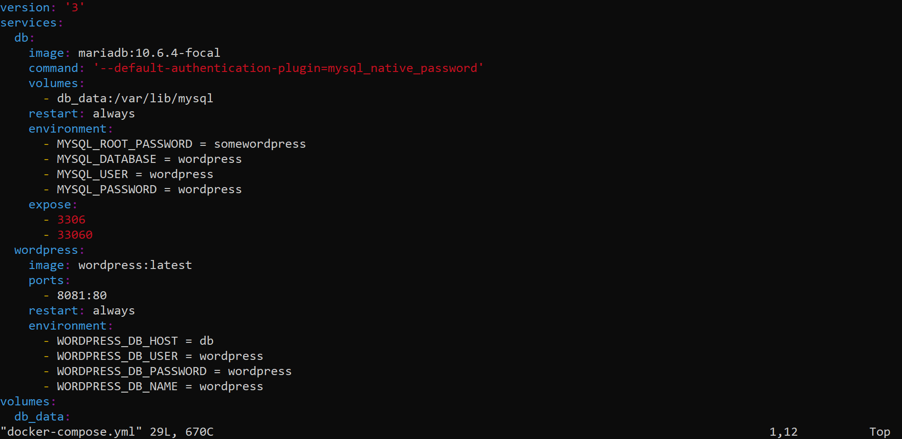

Slide 38
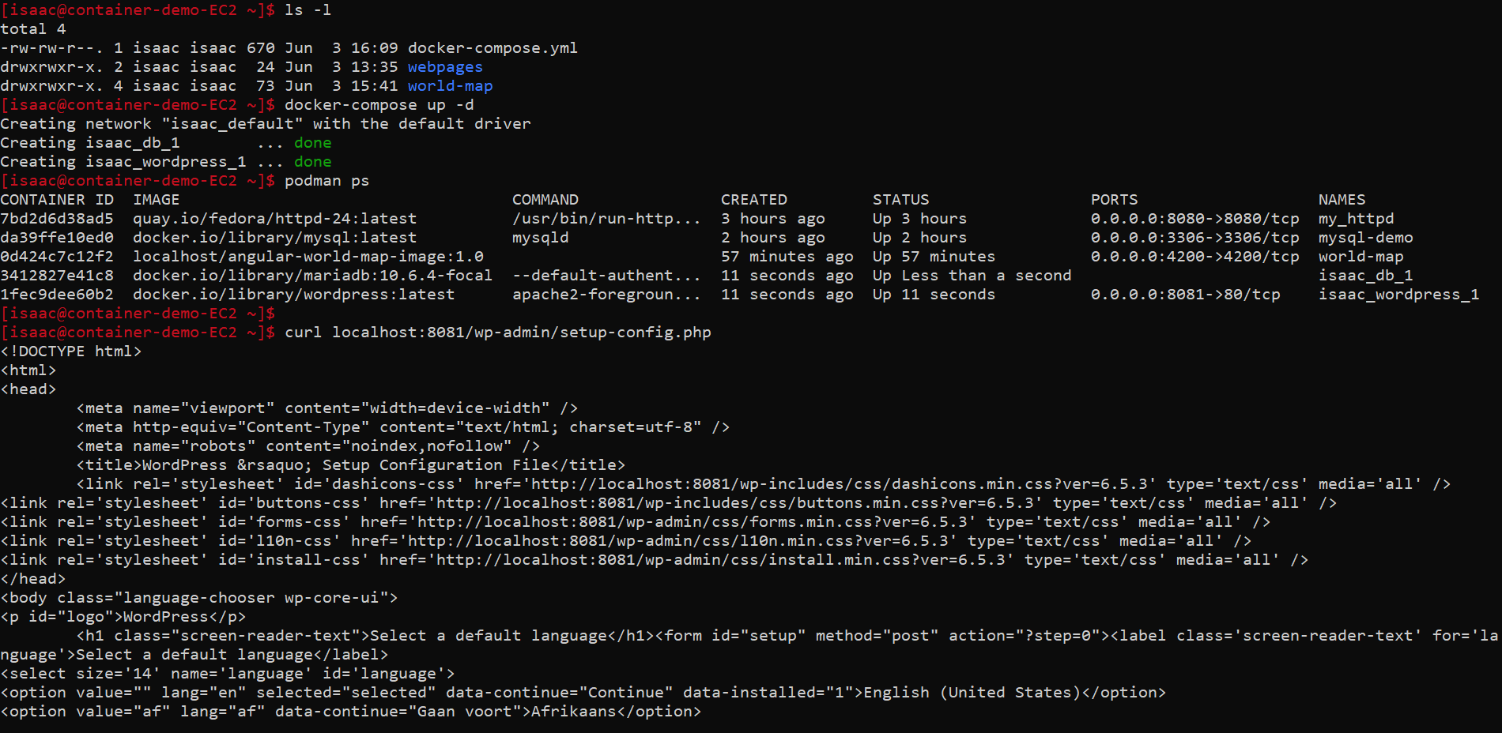

Slide 39
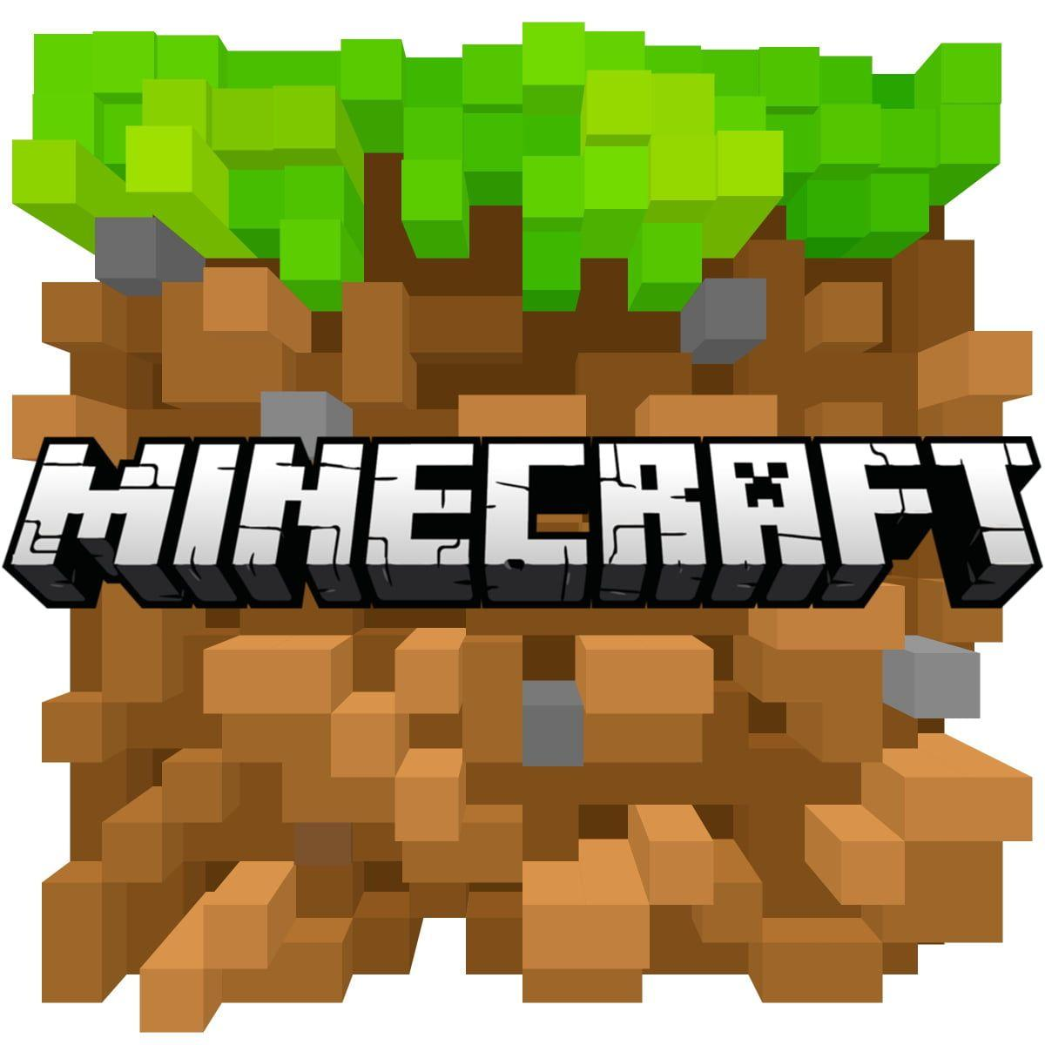
Example 6: Minecraft server with
“podman kube play”
Notes:
Chroot – 1982 on Unix, process has different root filesystem. If root process, can still do anything
FreeBSD Jail – 1999, similar to a VM, same kernel as host, greater security
LXC (linux containers) project – 2008, first intro to containers
Docker release 2013

Slide 40
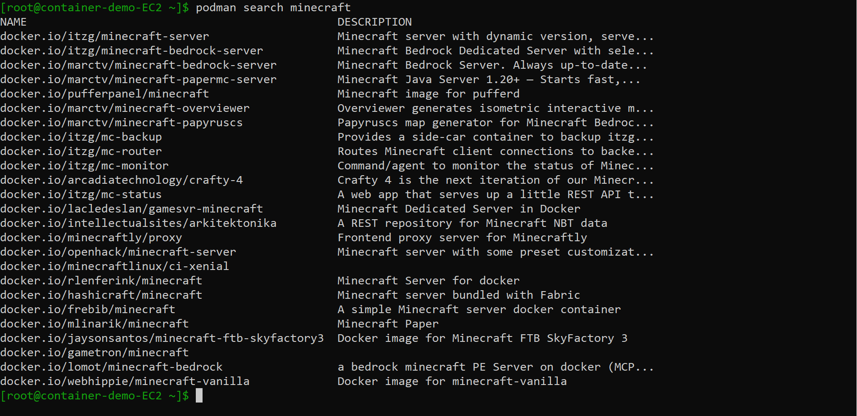

Slide 41
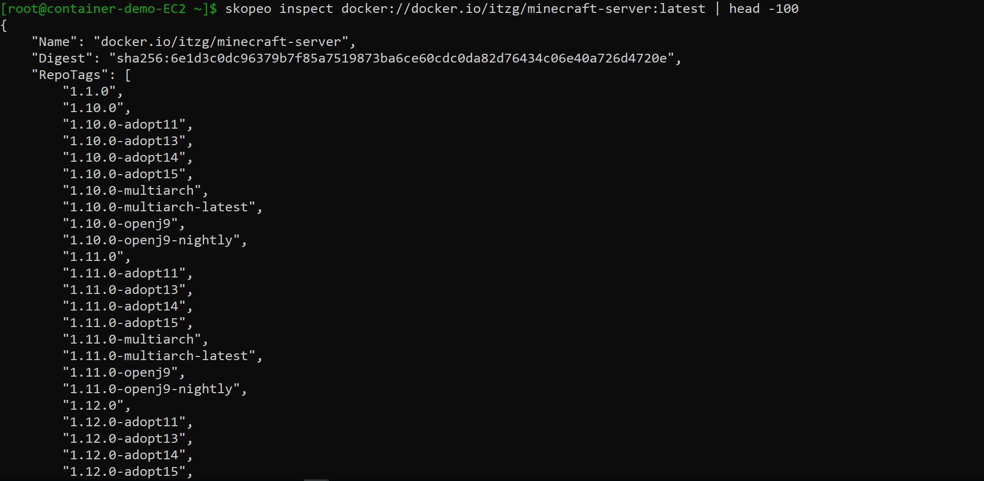

Slide 42
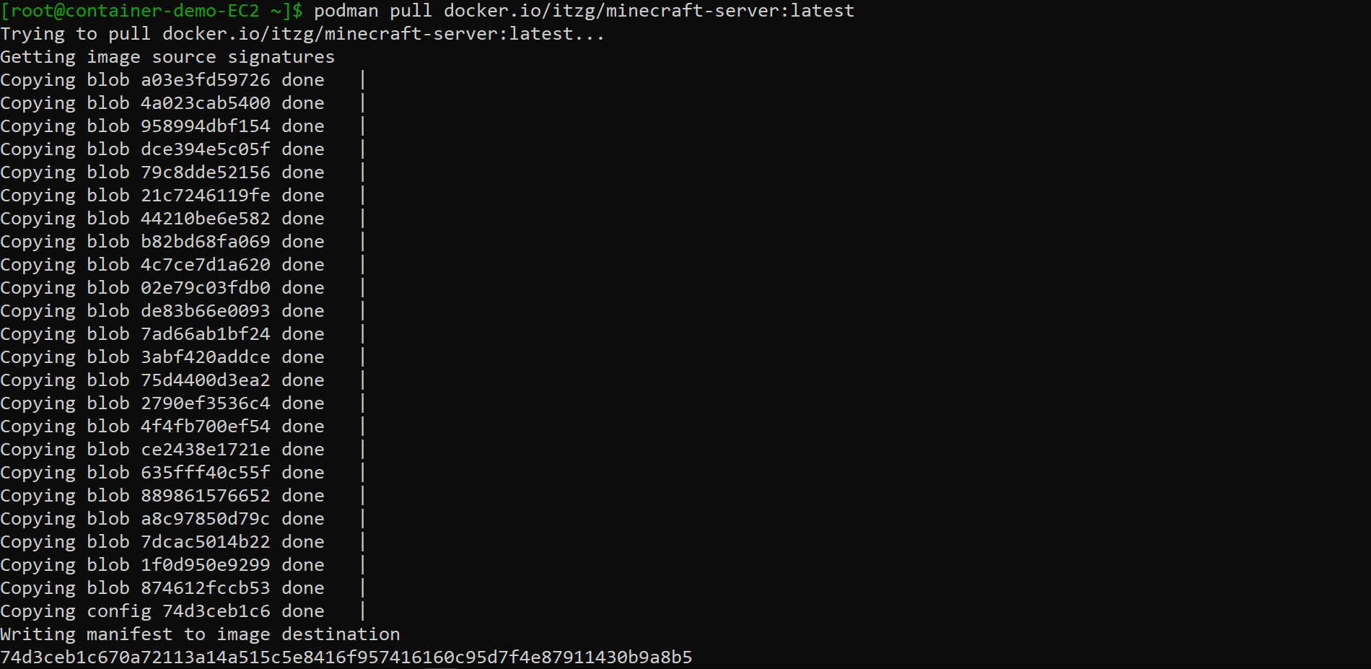

Slide 43
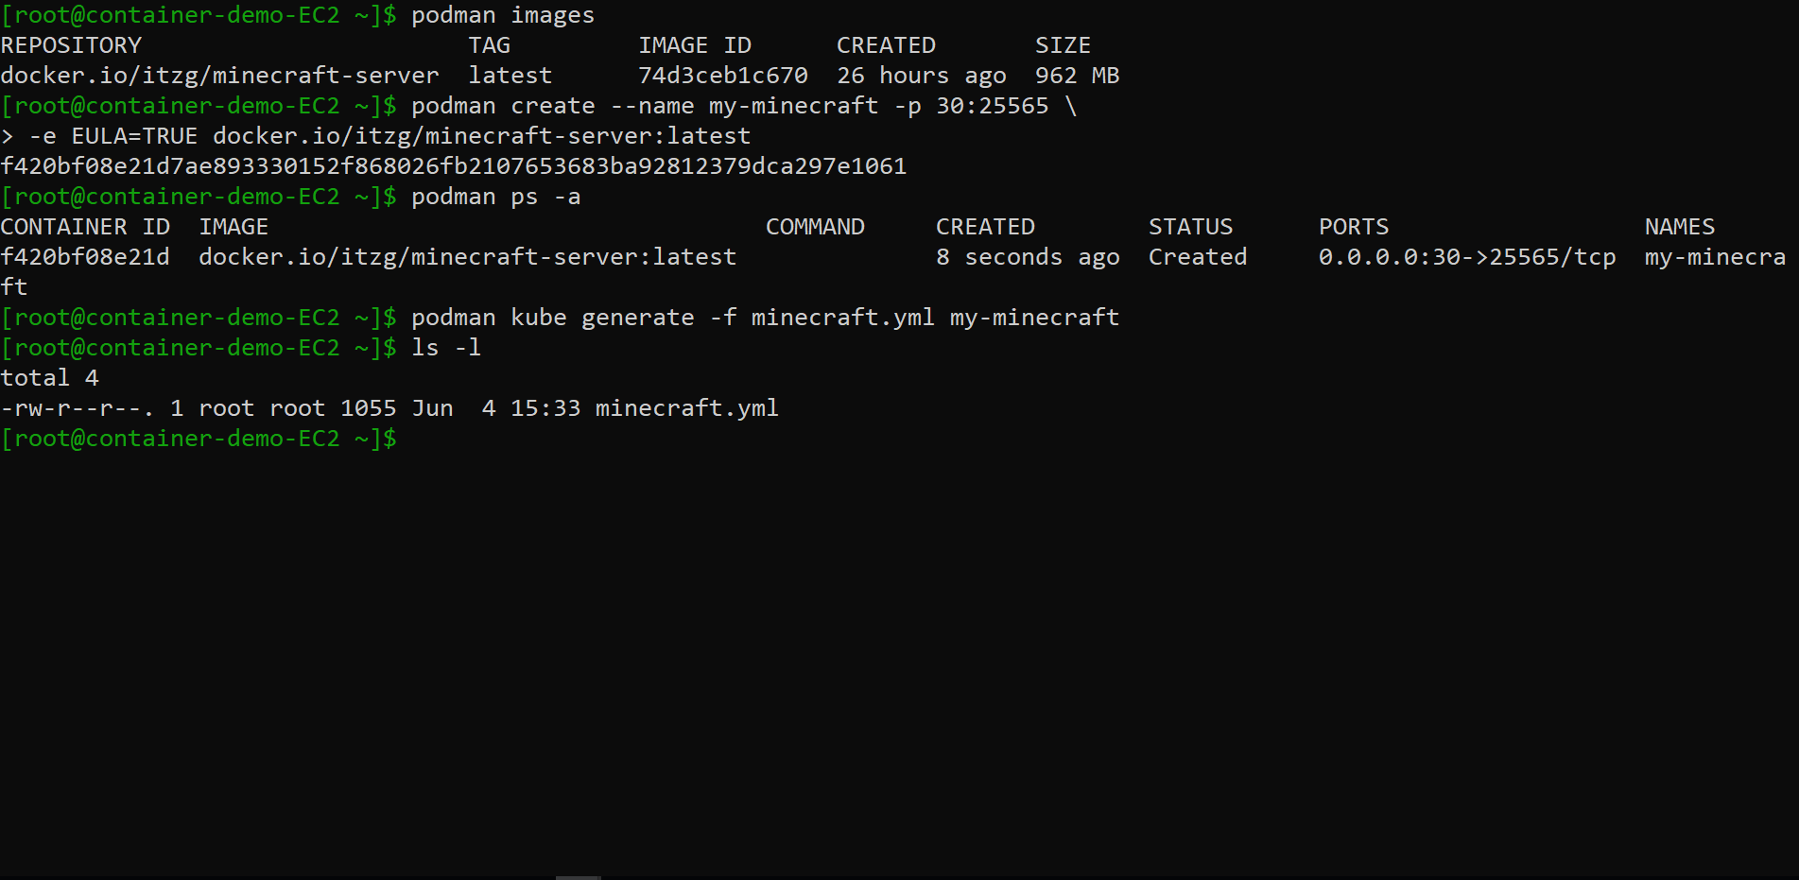

Slide 44
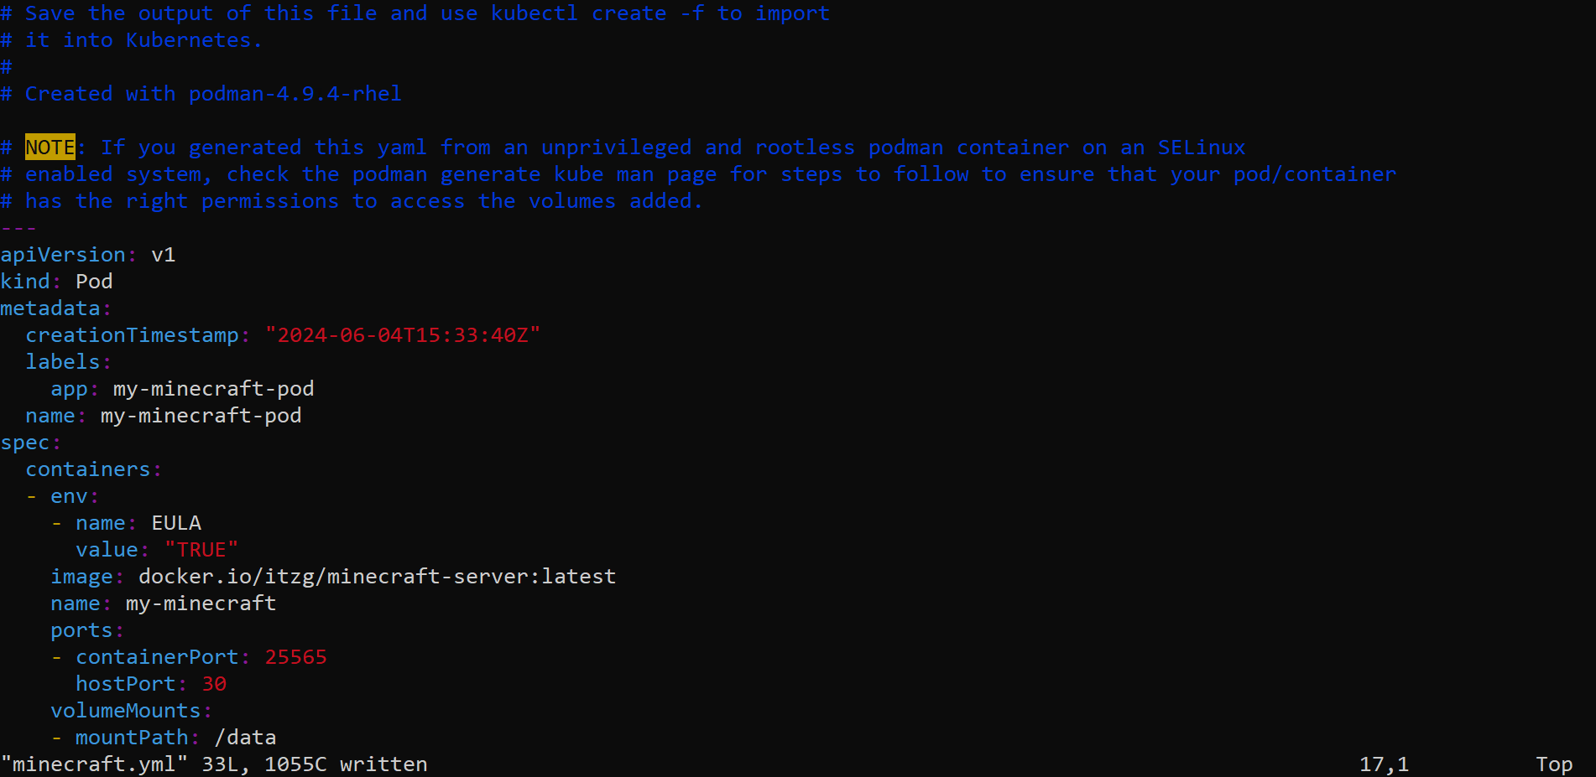

Slide 45
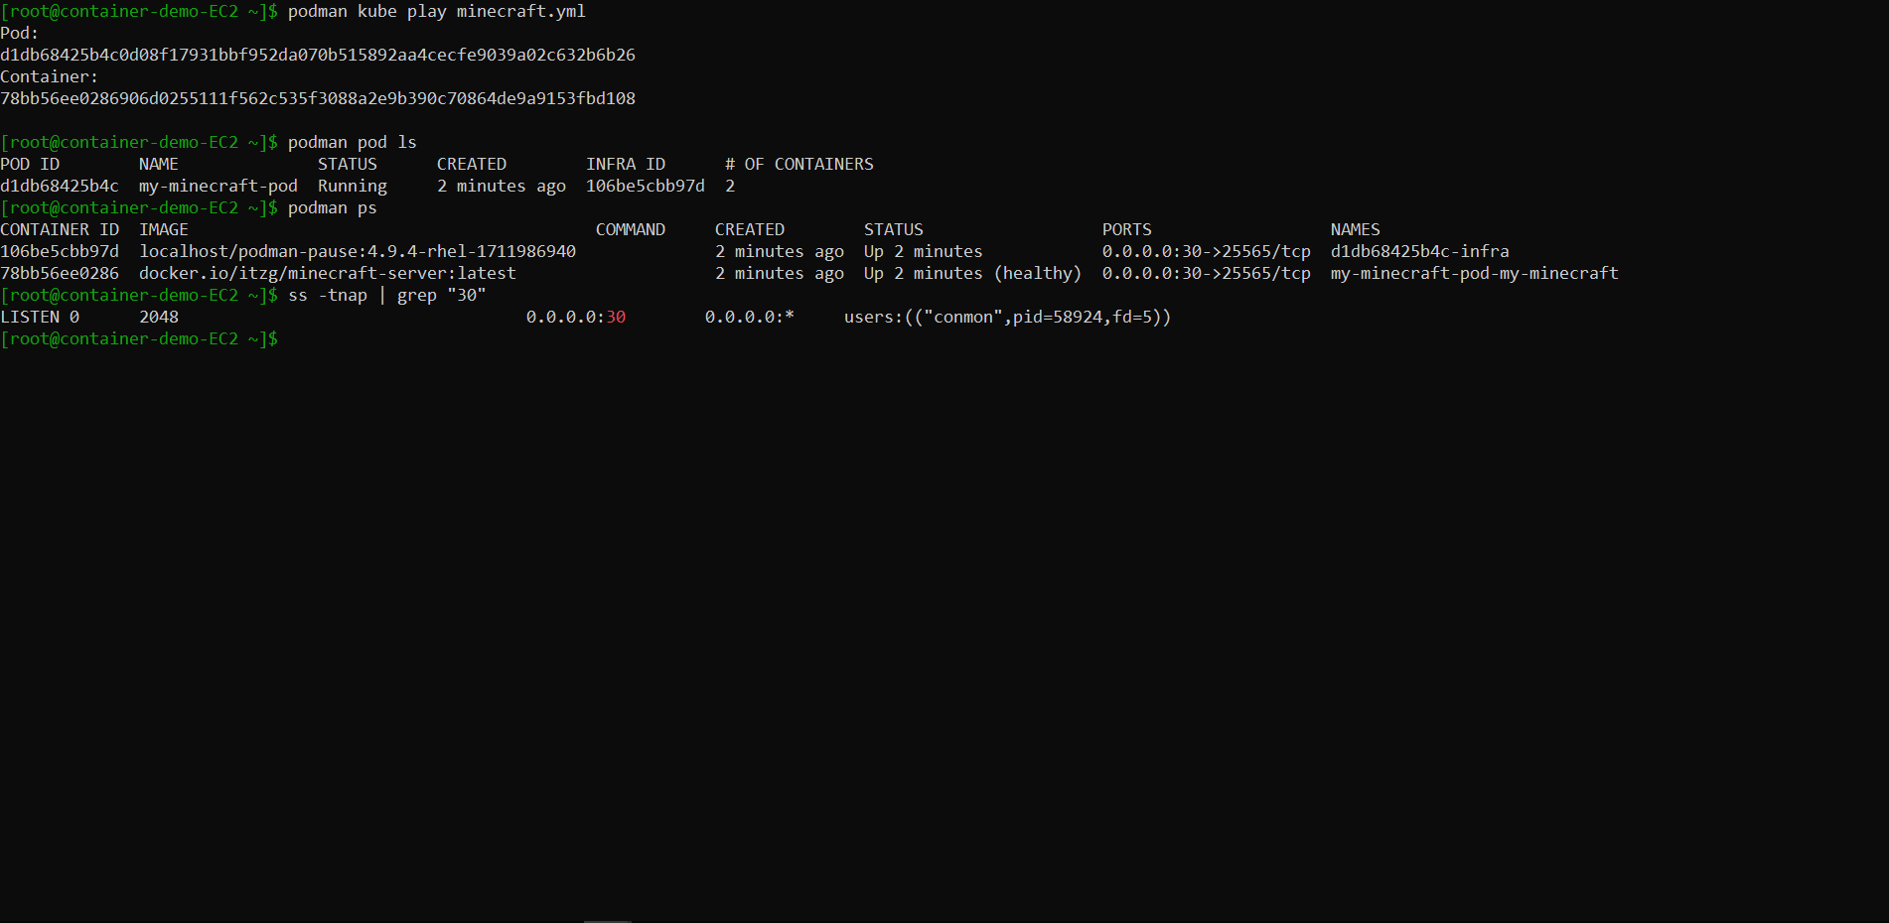

Slide 46
VS
All containers are run “rootless” by default
Standard in the Red Hat ecosystem
No dedicated daemon to manage containers
All containers are run as “root” by default
Much more popular
Dedicated daemon to manage containers

Slide 47
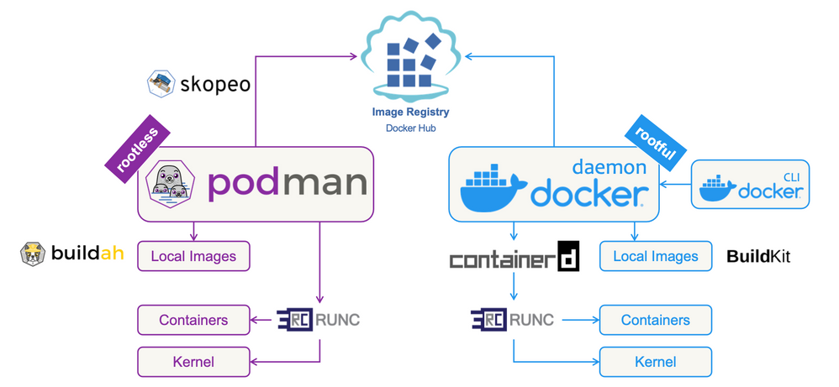
https://hub.alfresco.com/

Slide 48
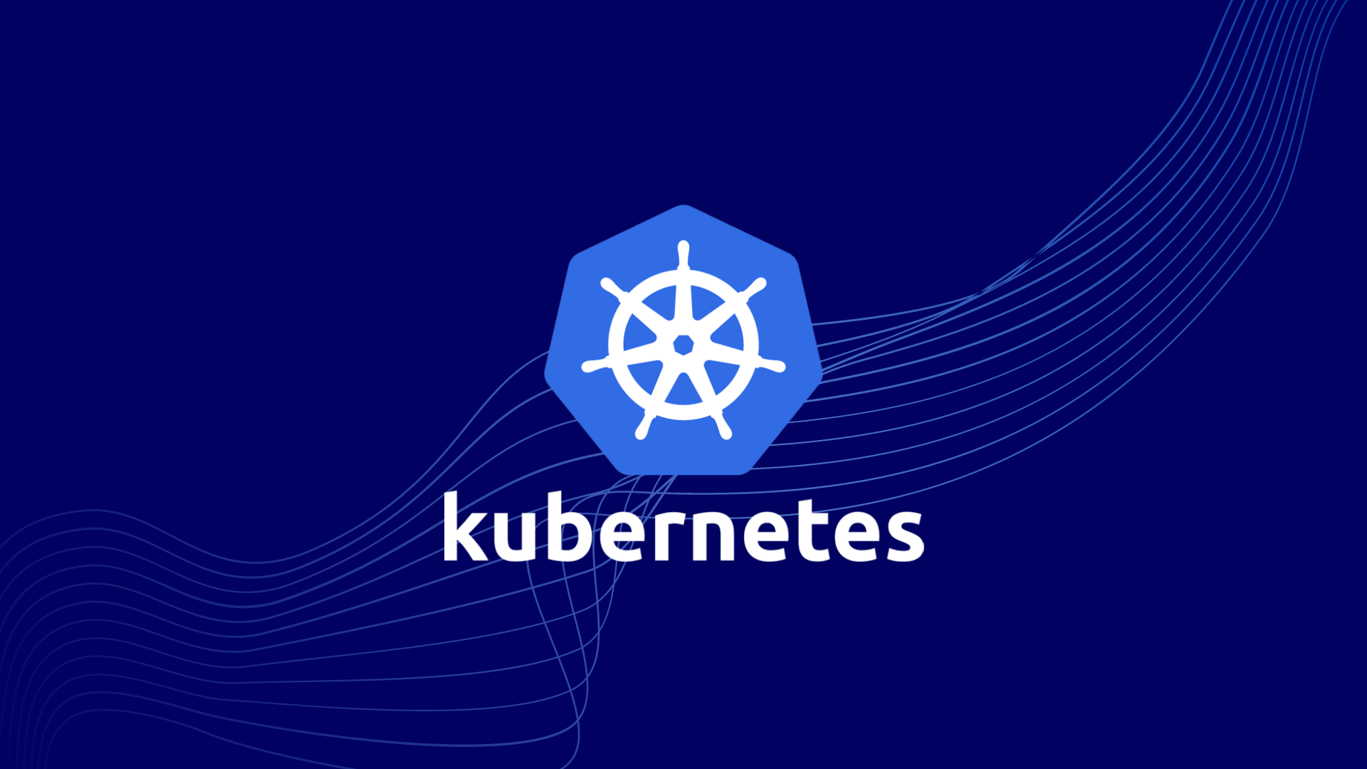

Slide 49
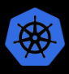
What is Kubernetes (k8s)?
Kubernetes is a platform for orchestrating containerized applications across a cluster of machines.
Specializes in running containerized applications at scale with no or minimal downtime
Posses auto-scaling and self-healing capabilities
Simplifies application deployment

Slide 50
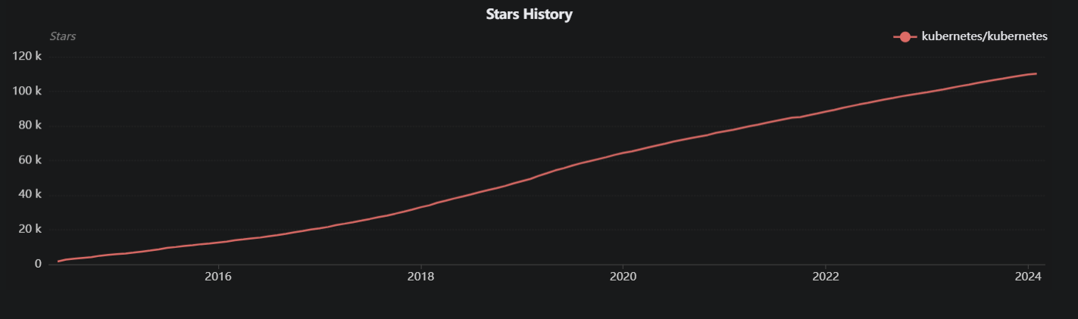
Kubernetes Origins
Written by Google – released and donated to Cloud Native Computing Foundation (CNCF) in 2015
Written in Go (Golang)
Top contributors: Google, Red Hat, VMware
#41 Most Popular Project on GitHub
https://ossinsight.io/

Slide 51
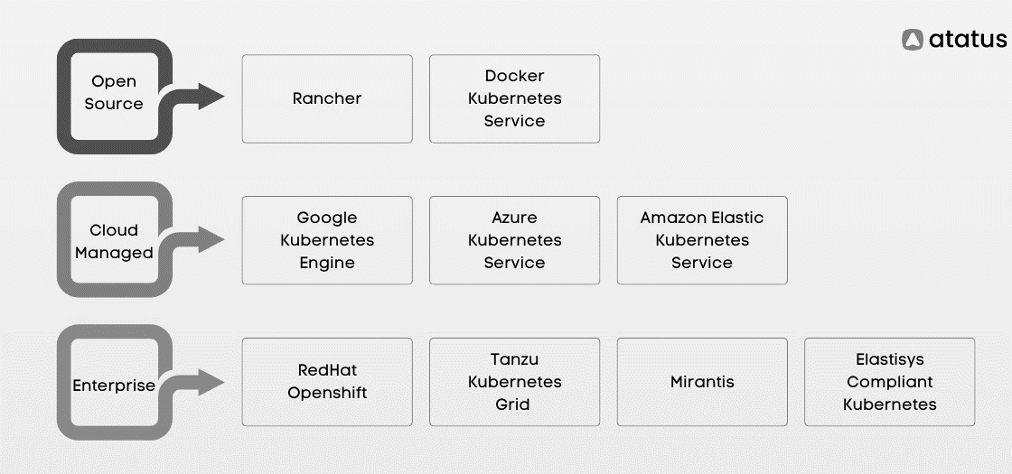
Kubernetes Distributions
https://www.atatus.com/

Slide 52
Kubernetes Manifests
apiVersion: apps/v1
kind: Deployment
metadata:
name: my-app
spec:
replicas: 4
selector:
matchLabels:
app: my-app
template:
metadata:
labels:
app: my-app
spec:
containers:
- name: my-app
image: my-app-image:latest
ports:
- containerPort: 80
Declare your Kubernetes cluster functionality and topology
YAML syntax

Slide 53



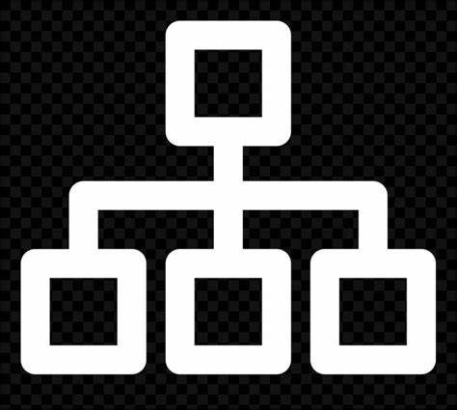

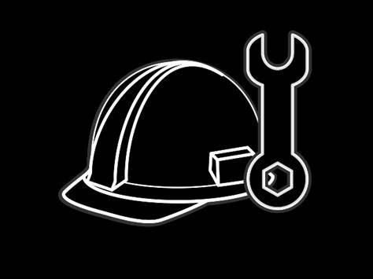

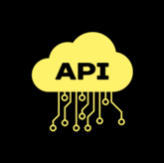
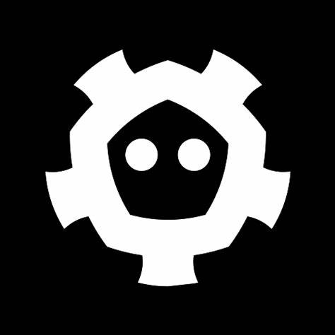

Worker Nodes
kube-proxy
APP
APP
Admin/Dev
YAML Manifests
Control Node
Pod
Pod
kubelet
Controller Manager
kube-proxy
APP
APP
etcd
API Server
Pod
Pod
Scheduler
kubelet
Container Runtime: Daemon that manages the lifecycle and all essential functions of local containers.
Scheduler: Assigns newly created Pods to Worker Nodes. Follows an algorithm to select most suitable Worker Nodes based on defined policy, CPU utilization, and memory utilization
Containerized Apps: Isolated applications with all necessary libraries and dependencies built in.
kubelet: Node Agent that registers every Worker Node with the API Server and opens a line of communication. Ensures that every Pod described in the YAML Manifests are running and healthy.
Pods: The smallest deployable units of computing in Kubernetes, consisting of one or more containers with shared storage and network resources, and a specification for how to run the containers.
etcd: Kubernetes (key: value) datastore. Stores ALL data for the cluster; including YAML Manifests, cluster state, and configurations. Vitally important to routinely backup.
Controller Manager: Continually checks and corrects the current state of the cluster to make it match the desired state.
YAML Manifests: Declare the Kubernetes cluster functionality and topology.
API Server: Communication hub of the k8s cluster; A REST API, running on port 443 w/ TLS. Performs all authentication and authorization inside of the cluster. Reachable via CLI, API call or UI (if available).
kube-proxy: Translates the desired state of the cluster into network rules on each Worker Node (iptables). Enables all Pod-to-Pod network communication and all Pod-to-external network communication.

Slide 54
apiVersion: apps/v1
kind: Deployment
metadata:
name: my-app
spec:
replicas: 8
selector:
matchLabels:
app: my-app
template:
metadata:
labels:
app: my-app
spec:
containers:
- name: my-app
image: my-app-image:v1
ports:
- containerPort: 80
Pods
v1
v2
v2
v1
By default, Rolling Updates guarantee no more than 25% of Pods will be down during update process
Ability to roll back to previous state in event of failed updates
v1
v2
v1
v2
Change to “v2” and apply
Rolling Updates
v2
v1
v1
v2
v2
v2
v1
v1

Slide 55
apiVersion: apps/v1
kind: Deployment
metadata:
name: my-app
spec:
replicas: 8
selector:
matchLabels:
app: my-app
template:
metadata:
labels:
app: my-app
spec:
containers:
- name: my-app
image: my-app-image:v2
ports:
- containerPort: 80
apiVersion: autoscaling/v2
kind: HorizontalPodAutoscaler
metadata:
name: my-app-hpa
spec:
scaleTargetRef:
apiVersion: apps/v1
kind: Deployment
name: my-app
minReplicas: 4
maxReplicas: 16
metrics:
- type: Resource
resource:
name: cpu
target:
type: Utilization
averageUtilization: 50
MATCH
Horizontal Pod Autoscaler

Slide 56
Horizontal Pod Autoscaler
Total Pod CPU Utilization:
Pods
400%
800%
200%
50%
50%
50%
50%
50%
50%
50%
50%
+400%
+200%
50%
50%
50%
50%
50%
50%
50%
50%

Slide 57
Kubernetes Learning Resources
https://kubernetes.io/docs/home/
https://www.youtube.com/@AntonPutra
https://www.youtube.com/@TechWorldwithNana
“The Kubernetes Bible” – Nassim Kebbani, Piotr Tylenda, Russ McKendrick
https://github.com/kelseyhightower/kubernetes-the-hard-way/blob/master/README.md

